Slide 1
Dual-Branch Subpixel-Guided Network for Hyperspectral Image Classification (DSNet)

Slide 2
Objective
This project aims to implement the Dual-Branch Subpixel-Guided Network (DBSGN) for hyperspectral image classification. Key architectural and training details are extracted from the reference. Standard hyperspectral datasets are used for training and evaluation. The goal is to reproduce the evaluation metrics and result tables from the paper.

Slide 3
Datasets
Indian Pines: contains 200 spectral bands from 400 to 2500 nm, 16 land cover classes on this dataset.
Covers an area of 145 × 145 pixels with 200 spectral bands.
Each pixel represents a different land cover type (crops, soil, trees).
Total Pixels:145 x 145 i.e; 21,025
Labelled Pixels: 10,336
✅ Common dataset for training deep learning models.

Slide 4
DSNet Architecture
Deep Auto encoder Un mixing Network: Designed to extract subpixel-level information from the HSI.
CNN-based Classifier Network: Extracts spectral-spatial information within the HSI to obtain pixel-level class features.
Subpixel Fusion Module: Integrates the abundance information and class features to ensure high-quality information fusion and enhance model representation capability.

Slide 5
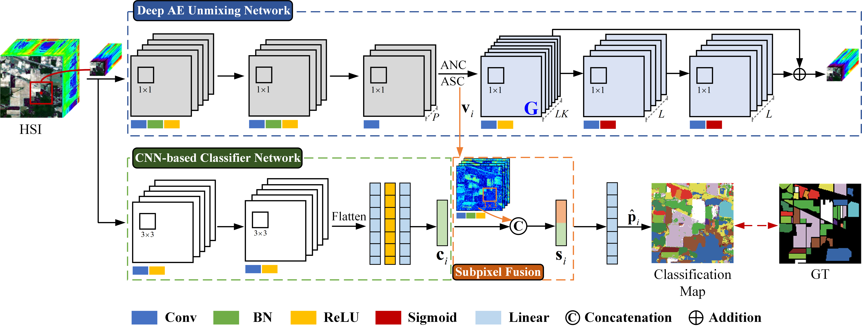
Given Architecture

Slide 6
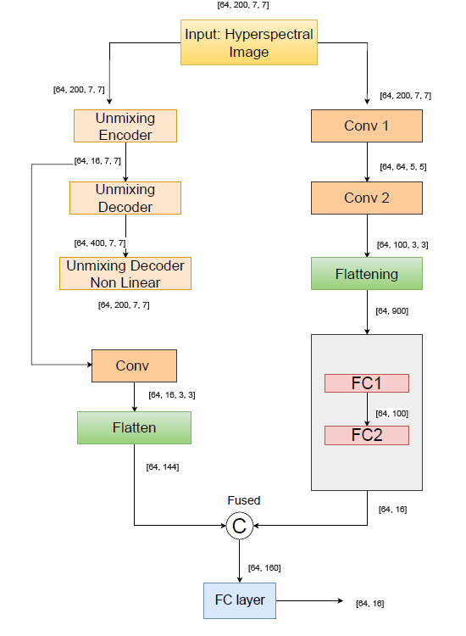
Obtained Architecture

Slide 7
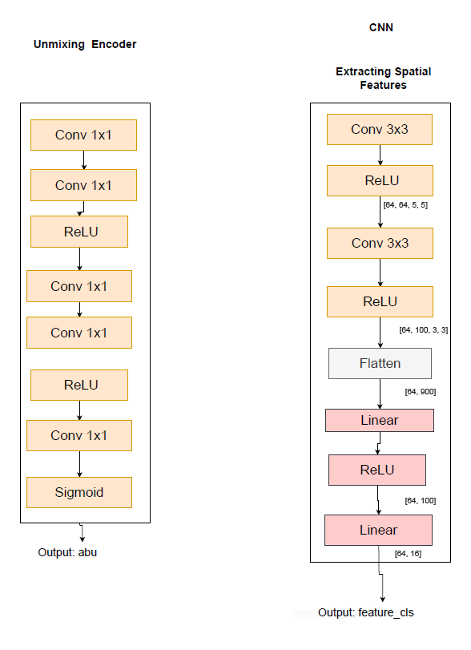

Slide 8
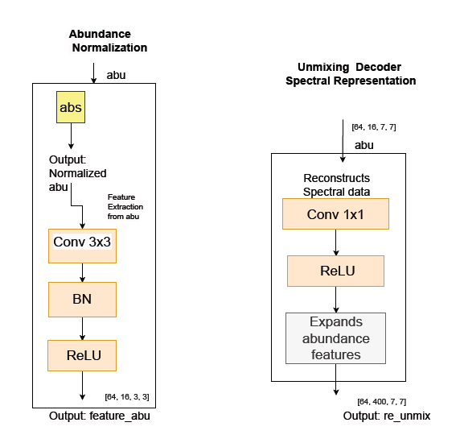

Slide 9

Mathematical Representations
AutoEncoder Unmixing:
Encoder:
yᵢ | Input vector
Wₑ | weight matrix
bₑ | bias vector
Wₑ·yᵢ + bₑ | Linear transformation
f(·) | Non-linear activation function
fₑ(yᵢ) | Output feature vector

Slide 10


Decoder:
vᵢ | Input vector
W(d₁) | weight matrix
W(d) | weight matrix for the second transformation
Φ(·) | Non-linear activation function
W(d₁)vᵢ | Linear transformation of input features
Φ(W(d)vᵢ) | Non-linear transformation
yᵢ | Output vector
CNN-based Classifier Network:
xᵢ | Input image
fᶜᴺᴺ(·) | CNN function, representing the feature extraction process
cᵢ | Output feature vector

Slide 11

Subpixel Fusion Module:
vi | Spectral feature vector at position i
Wsub, bsub | Learnable weights and bias in the subpixel branch
BNγ,β(·) | Batch Normalization with learnable scale (γ) and shift (β)
f(·) | Non-linear activation function (e.g., ReLU)
Flatten(·) | Flattens the tensor to 1D
ci | CNN-based spatial feature vector at position i
si | Final fused feature vector used for classification

Slide 12

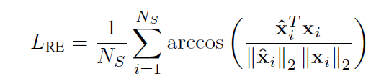
Loss Functions
L | Final Loss | Combined loss for model optimization.
L RE | Reconstruction Error | Measures input reconstruction accuracy.
L CE | Cross-Entropy Loss | Measures classification prediction accuracy.
λ | Weighting Factor | Balances both
NS | Number of spectral samples (pixels)
xi | Ground truth spectral vector for sample
x^i | Reconstructed spectral vector for sample
∥⋅∥2 | L2 norm of the vector

Slide 13

L CE | Cross-entropy loss
NSN_S | Number of samples
pi | True vector
p^i | Predicted probability vector
log⁡(p^i) | Element-wise log of predicted probabilities

Slide 14
Evaluation Metrics
DSNet's performance is measured using:
- Overall Accuracy (OA)-Measures the percentage of correctly classified pixels out of the total dataset.
- Average Accuracy (AA)-Computes the mean accuracy across all classes.
- Kappa Coefficient-used to evaluate the agreement between predicted and actual classifications , having chance that they might agree.
Higher OA, AA, and Kappa indicate better classification accuracy.

Slide 15
Results and Comparison
DATASET | ACTUAL RESULT | OBTAINED RESULT
OA(%) | 93.08 | 92.17
AA(%) | 96.31 | 95.42
Kappa(%) | 92.08 | 91.12

Slide 16
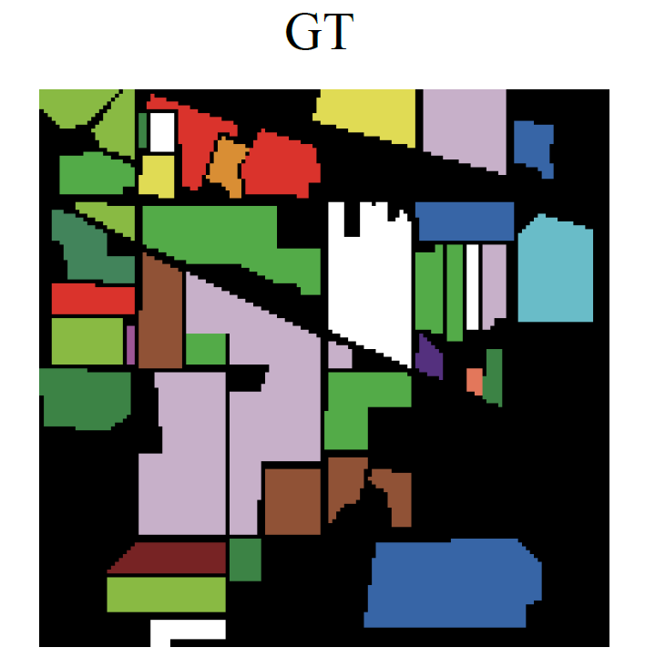
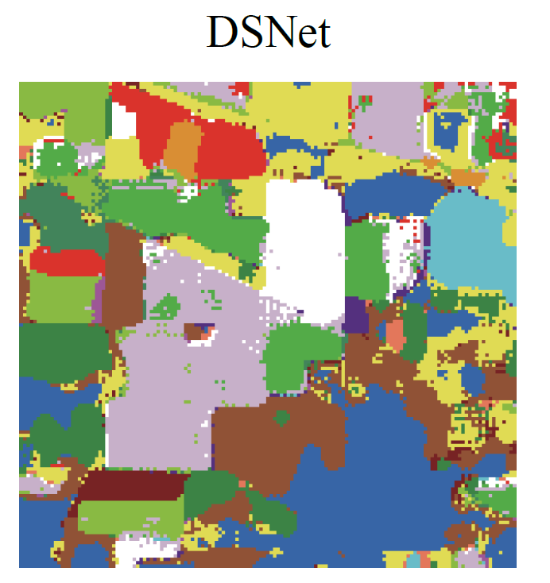
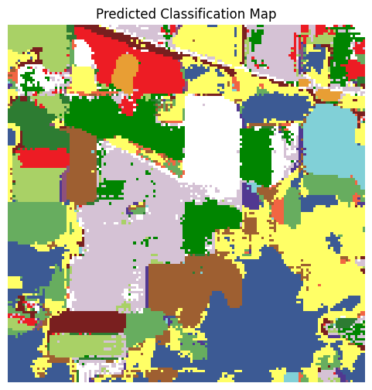
GROUND TRUTH
OBTAINED CLASSIFICATION MAP
ACTUAL CLASSIFICATION MAP

Slide 17
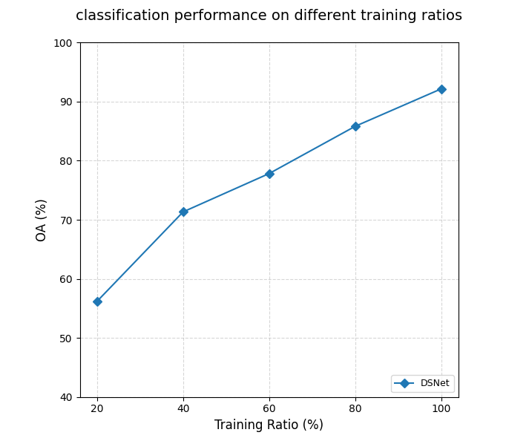

Slide 18
Thankyou!

